Slide 1
ELE 635
Modulated Communication Systems under Noise
Spring 2015

Slide 2
Why Study Random Process?
Information carrying signals are random, i.e. the receiver does not know a priori what waveform is going to be sent by the transmitter.
Noise signals that perturb information signals are also unpredictable and random.
A random signal is described by its statistical properties such as mean, variance, etc.

Slide 3
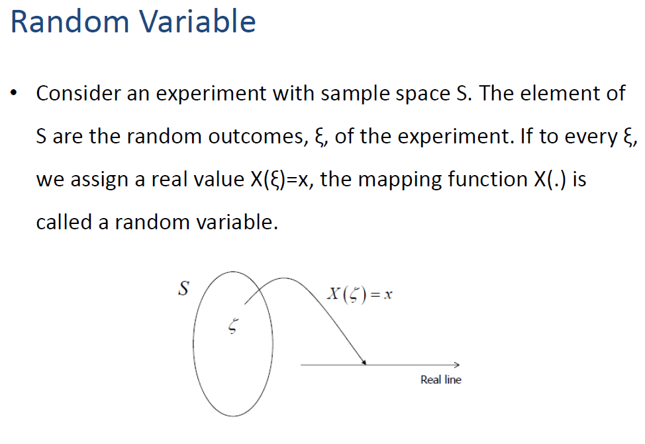
(Formal Definition)

Slide 4
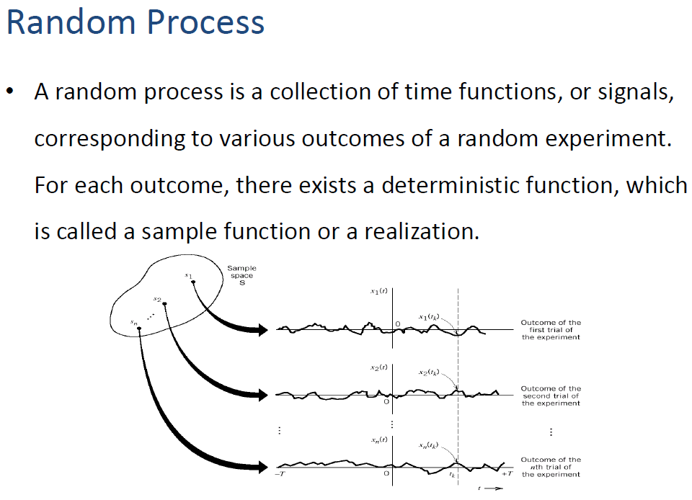
Ex: Temperature at different days
day1
day2
day3

Slide 5
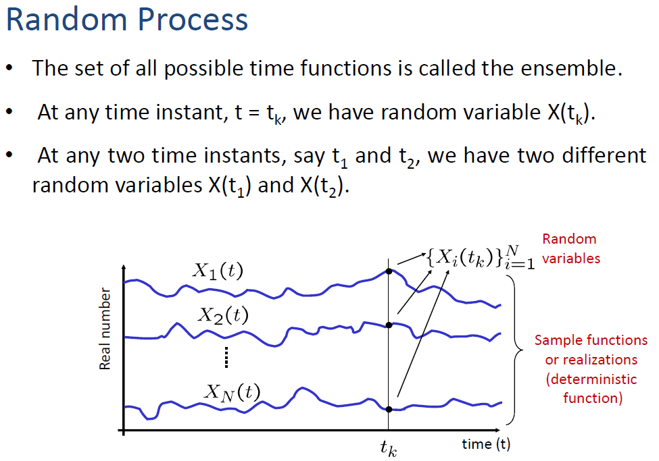

Slide 6
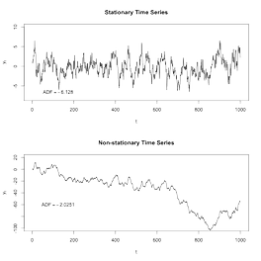
Characterizing Random Processes
Since a RP is not exactly predictable, we can’t write a mathematical expression for its waveform (or spectrum)
However, we can characterize a RP, by,
  Predicted maximum/minimum values
  Stationary or not
  Expected (mean) value
  How fast it varies (bandwidth)
  Variance (power) etc.

Slide 7
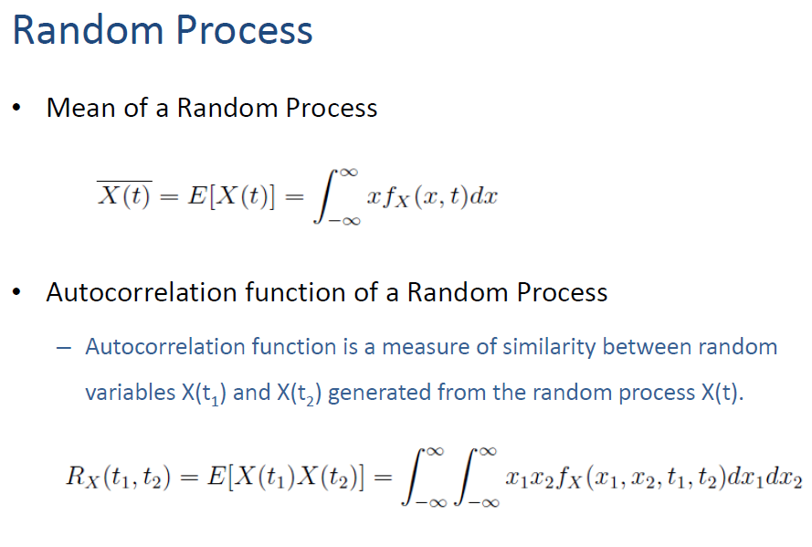
Dice Example:
Mean =
(Same random process at two time instances)

Slide 8
Repeatability of a RP
If the ‘characteristics’ of a RP remain the same over time, we say it is a stationary RP.
If all the ‘characteristics’ remain the same over time → Strictly Stationary RP.
If few key ‘characteristics’ remain the same over time → Wide Sense Stationary RP.
WSS processes are found in many practical cases.
WSS RP is a subset of Strictly Stationary RP

Slide 9
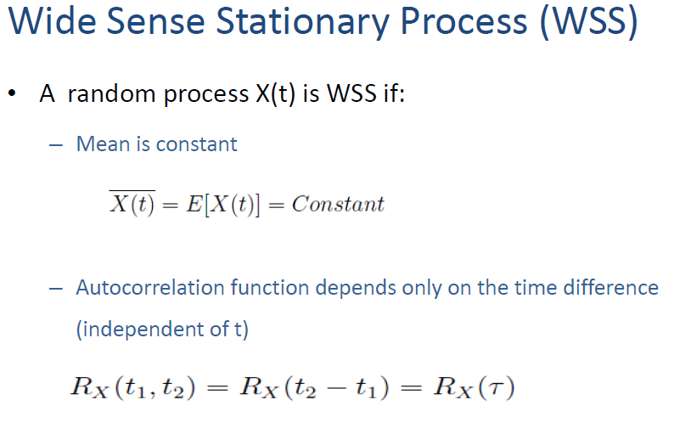

Slide 10
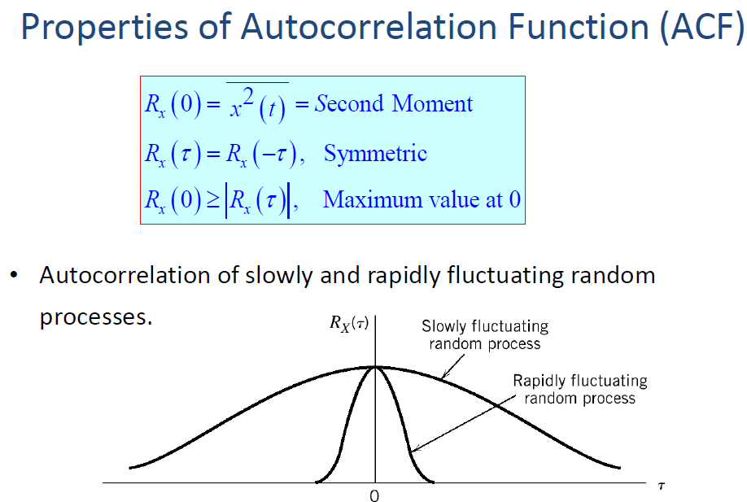

Slide 11
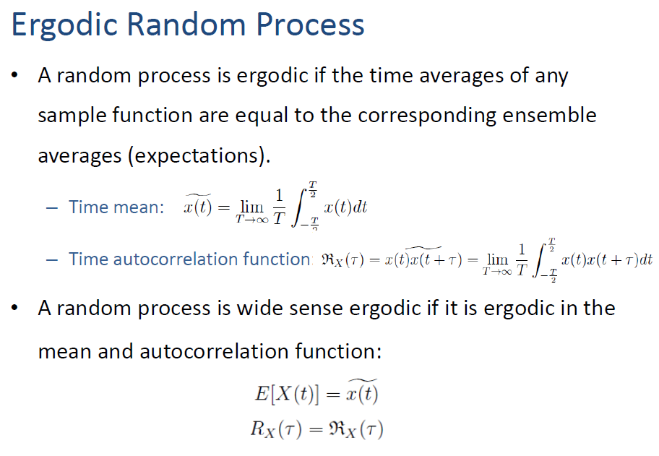

Slide 12
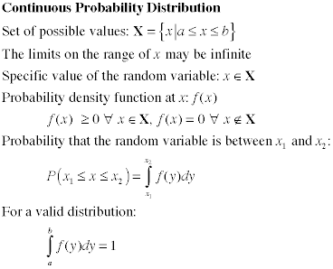
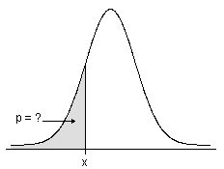
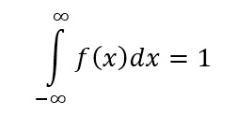
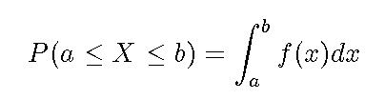
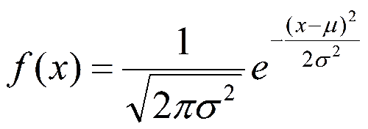
Probability Density Function (PDF)
PDF of a RP tells the probability of getting each amplitude value of the RP.
If ACF describes how the RP behaves w.r.to time, PDF tells how the RP behaves w.r.to amplitude.
Area = 1
Most noise processes have
Gaussian PDF →

Slide 13
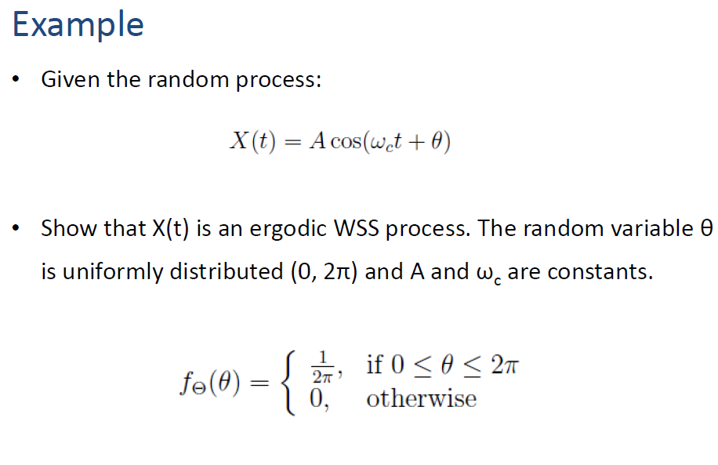

Slide 14
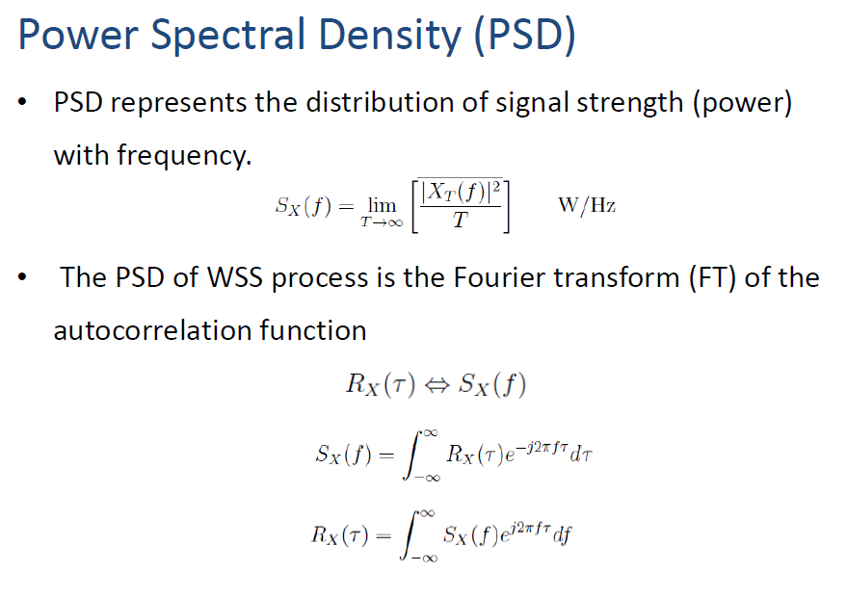

Slide 15
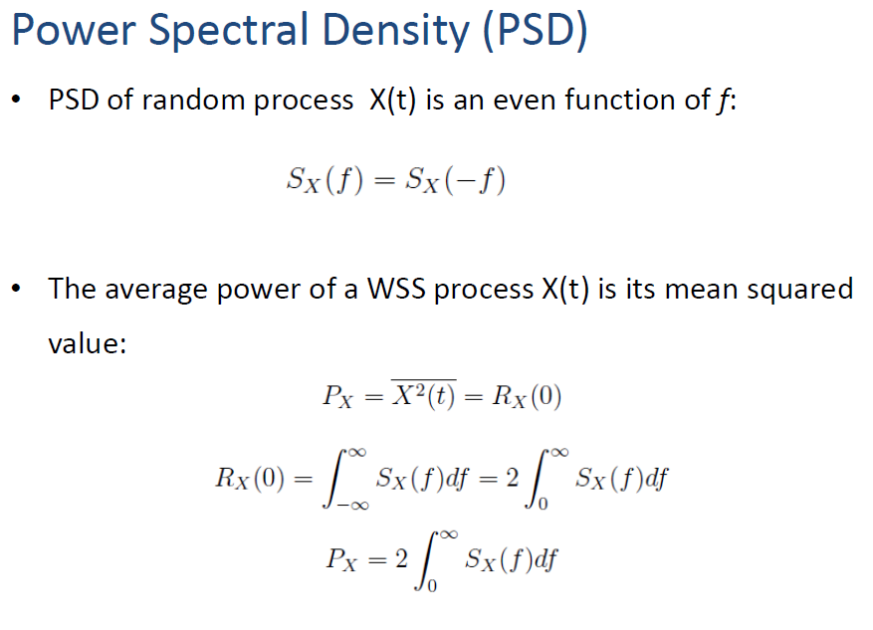


Slide 16
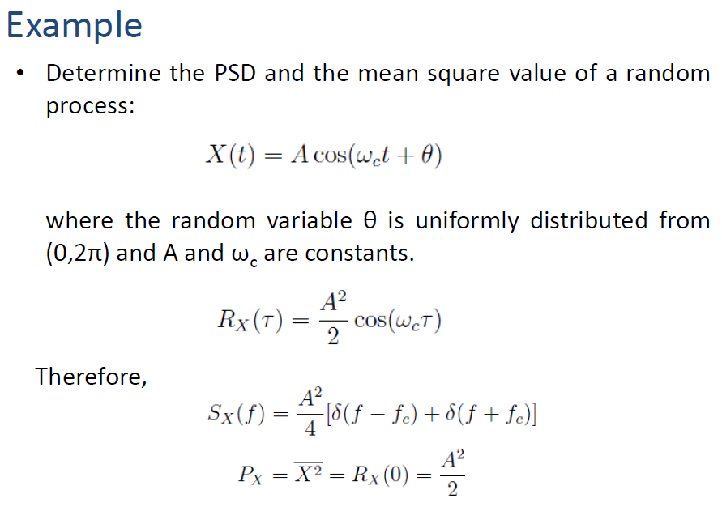

Slide 17
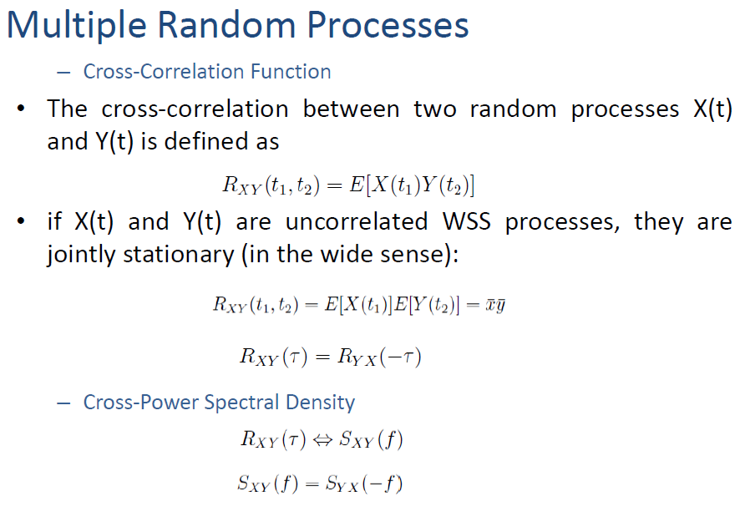

Slide 18
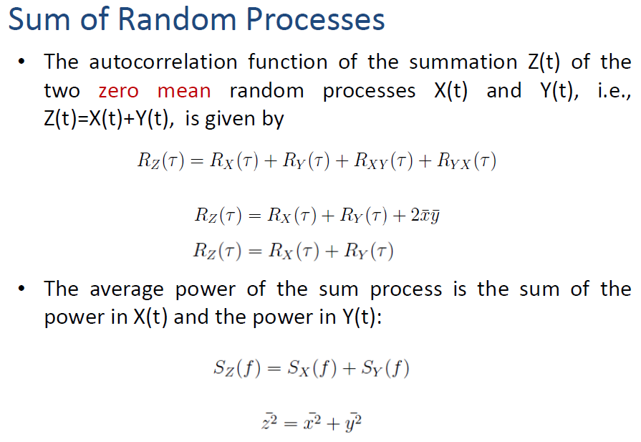

Slide 19
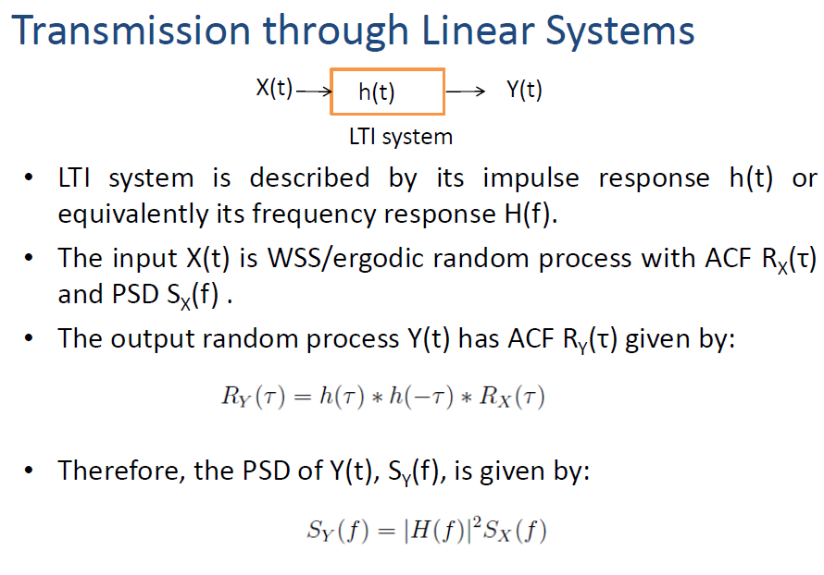

Slide 20
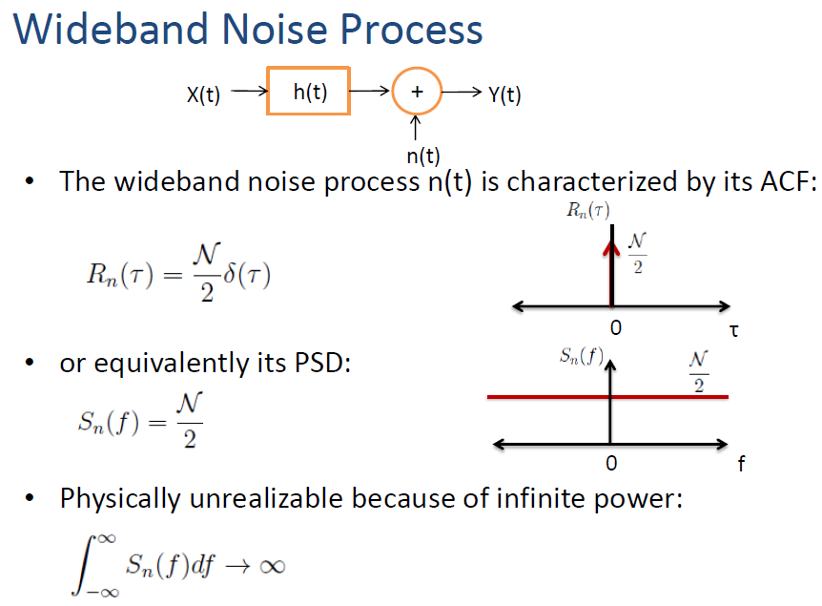
White noise has
Flat spectrum (PSD)
Impulsive autocorrelation function (ACF)

Slide 21
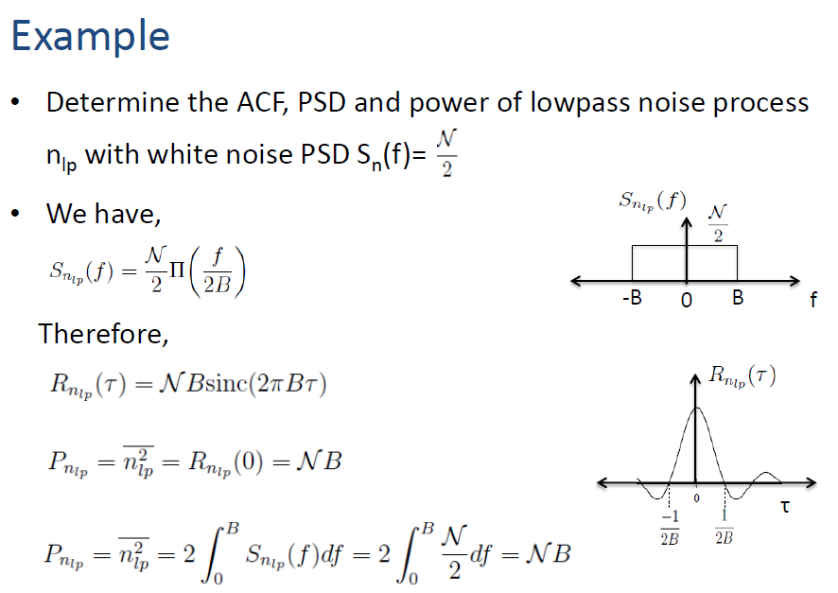

Slide 22
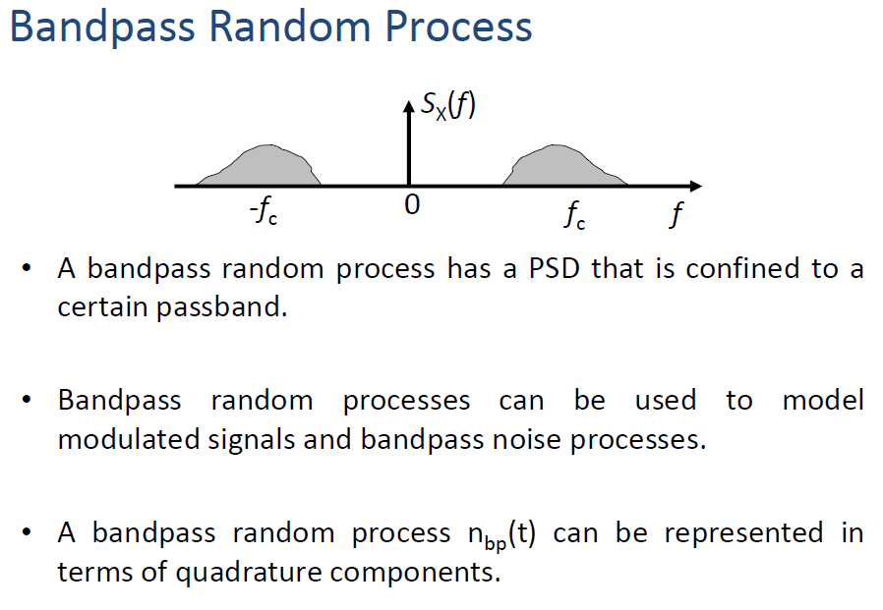

Slide 23

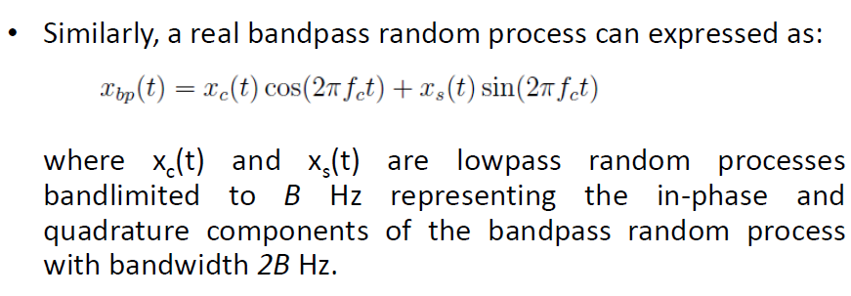

Generally,
Compare with QAM signal (we studied earlier):

Slide 24

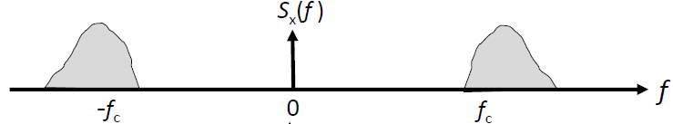

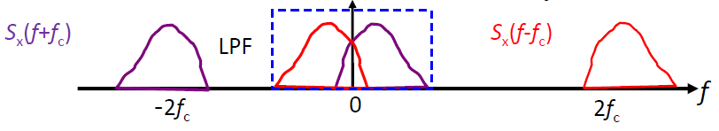
Consider the shifted PSD to the left and right

Slide 25
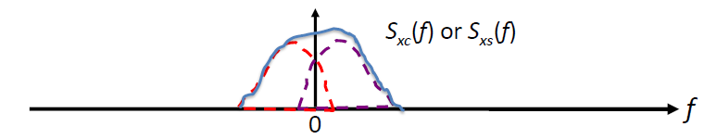


In order to have bandpass S_{x}(f), S_{xc}(f) and S_{xs}(f) shall be low pass as shown,
Since the ACF of the inpase and quadrature components are
the same, their PSD will also be the same.

Slide 26
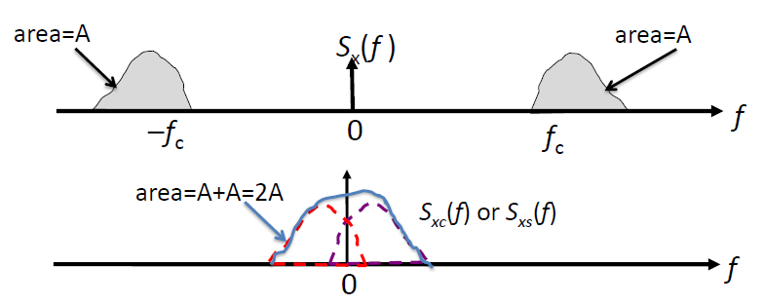
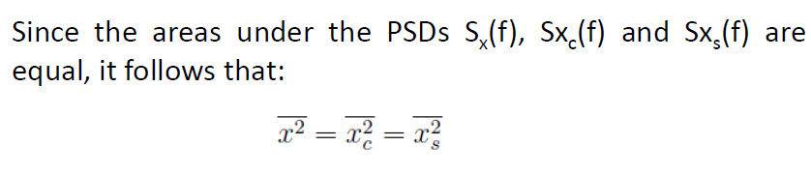
Area = 2A

Slide 27
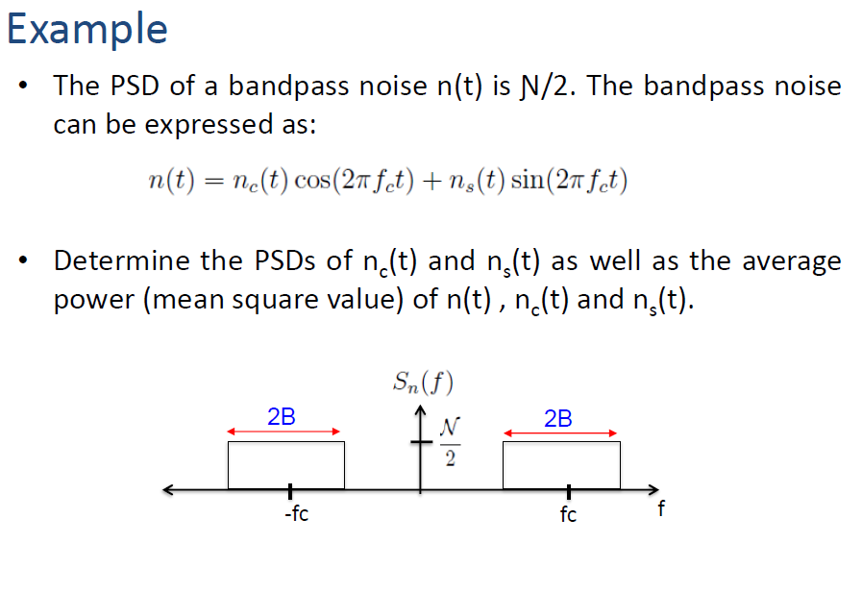
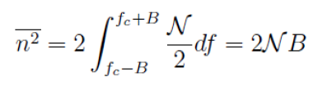
= Area under both rectangles

Slide 28
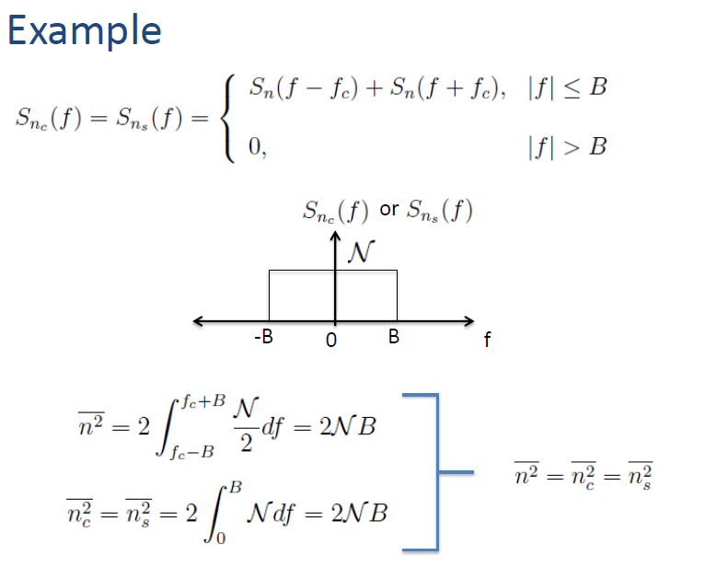

Slide 29
Now we see how each modulation scheme performs under noise
Performance Analysis

Slide 30
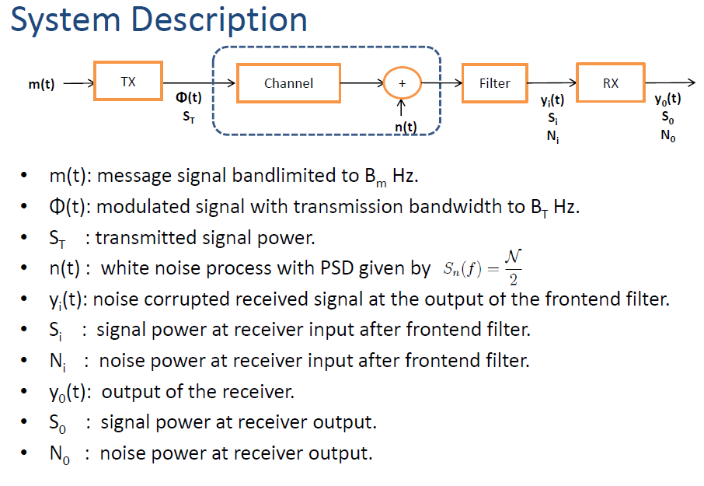



Slide 31
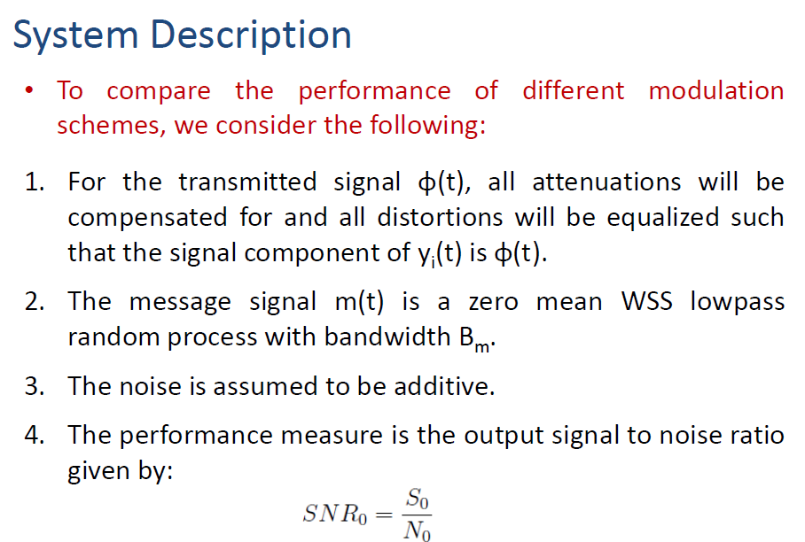

Slide 32
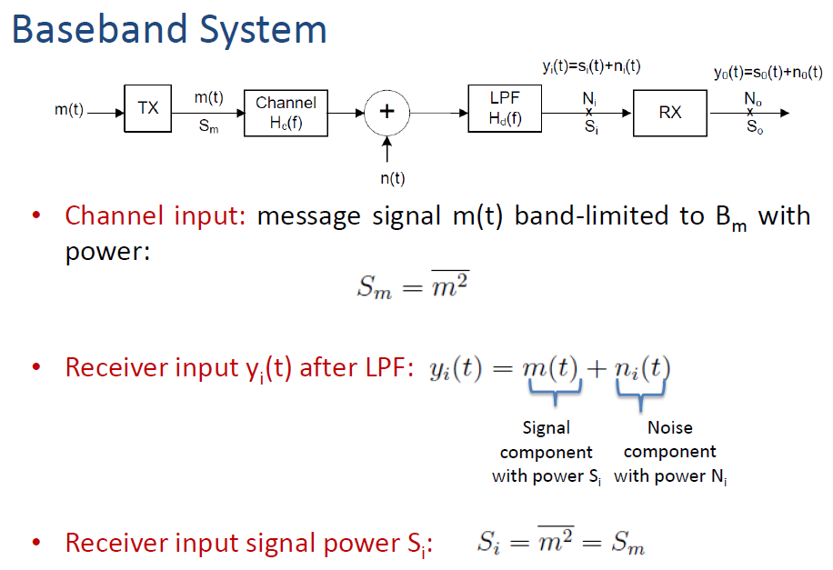
(No carrier modulation)

Slide 33
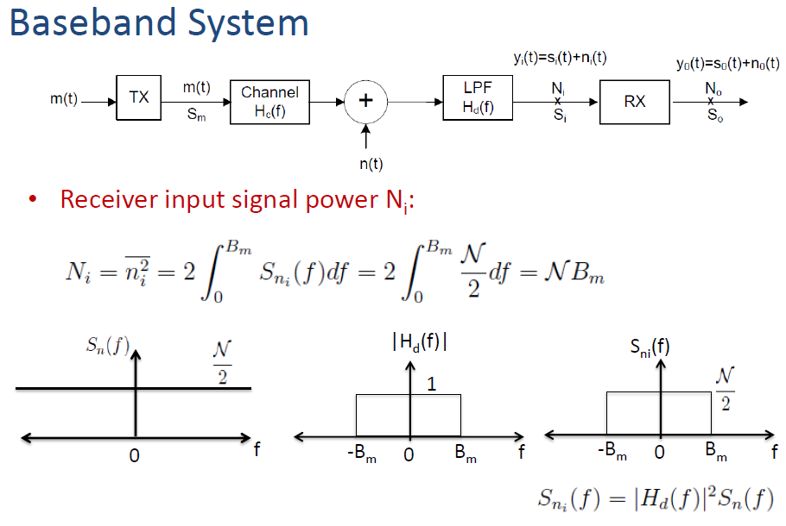

Slide 34
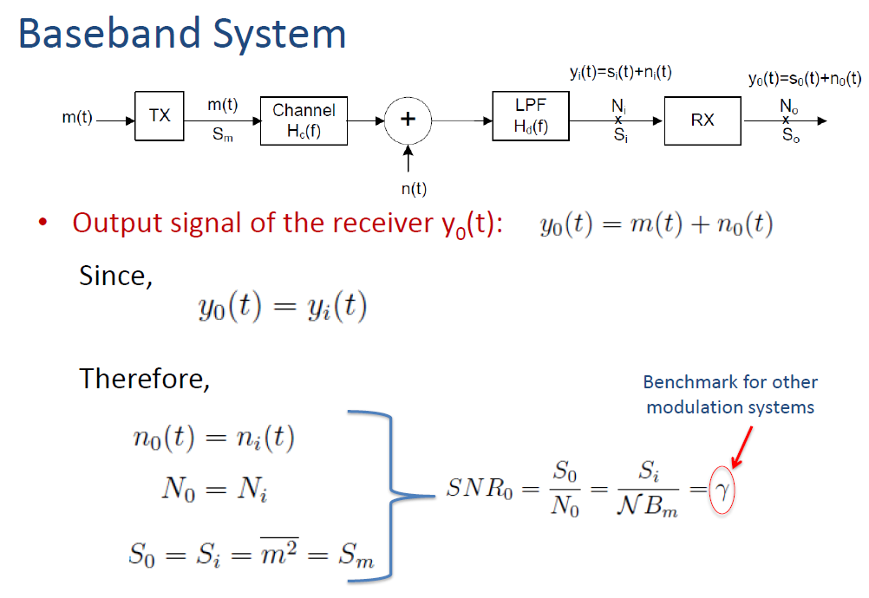
(No demodulation at the receiver)

Slide 35
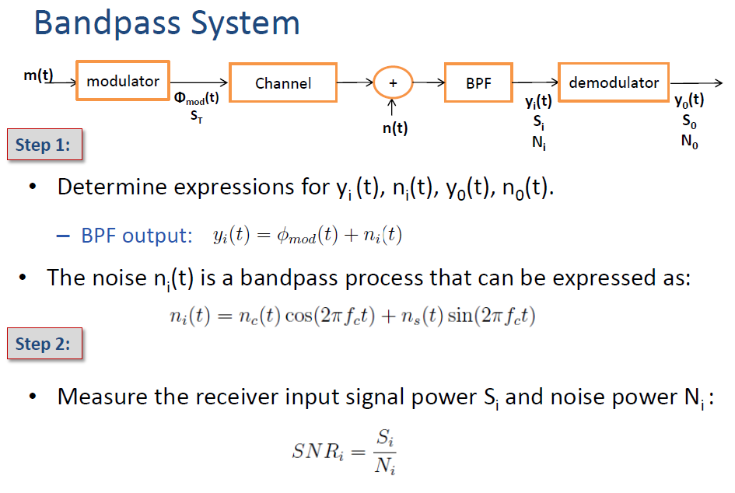
Steps for Evaluating
(With carrier modulation)

Slide 36
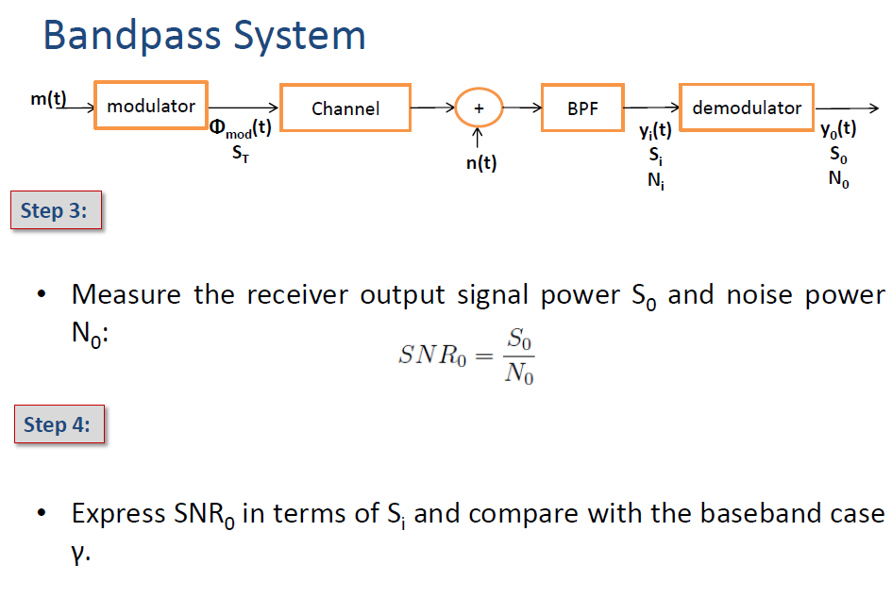
Steps for Evaluating

Slide 37
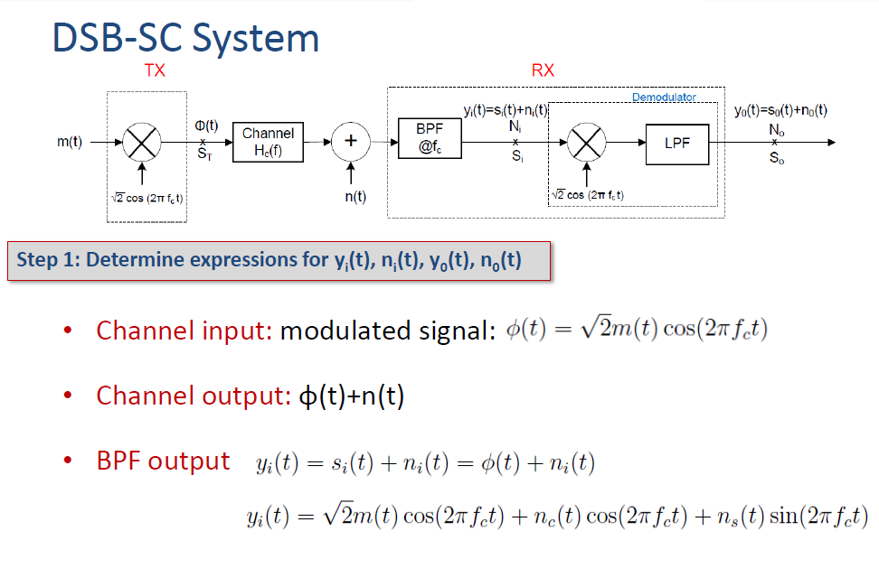

Slide 38
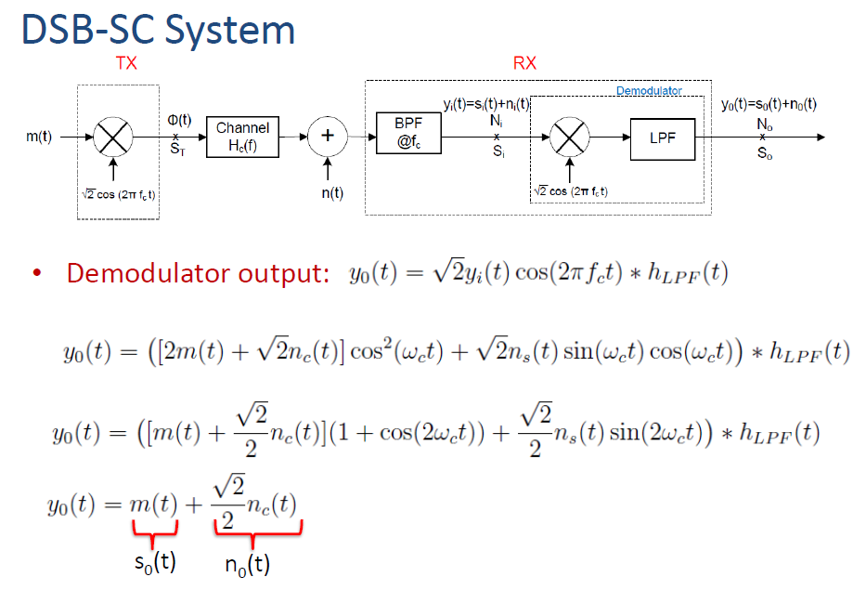
(Note: Only inphase noise appears)

Slide 39
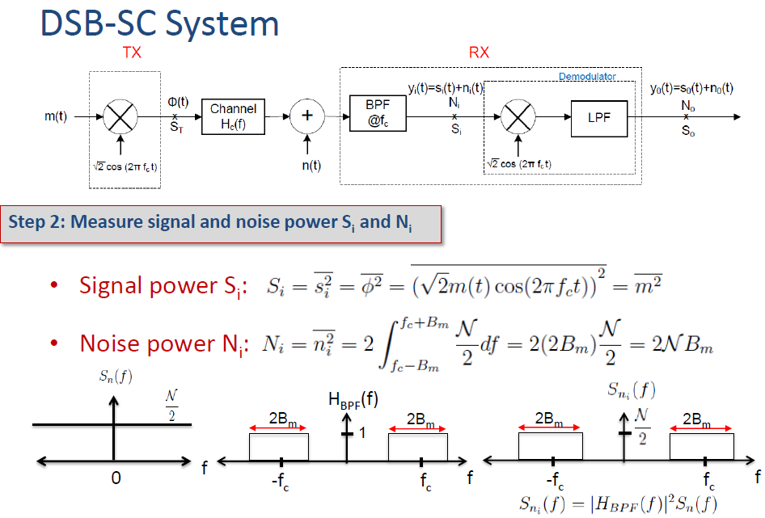

Slide 40
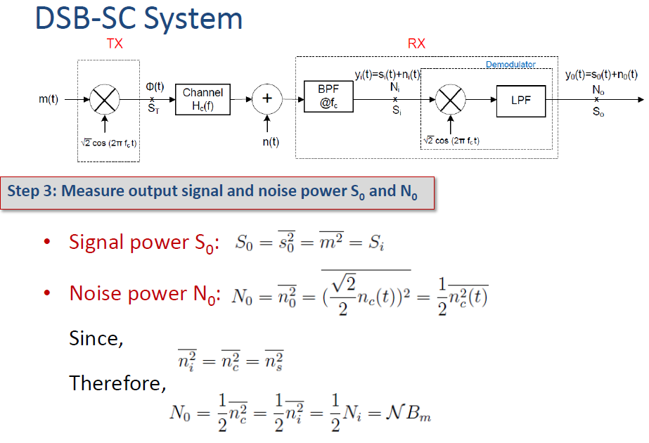

Slide 41
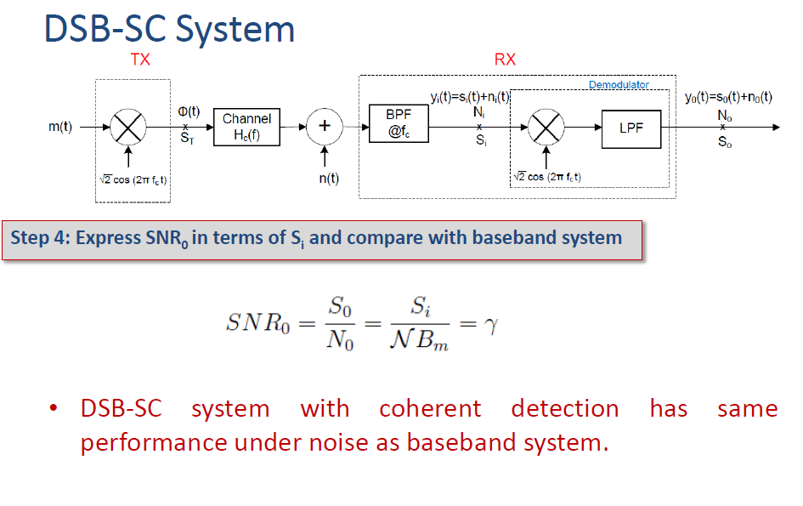

Slide 42
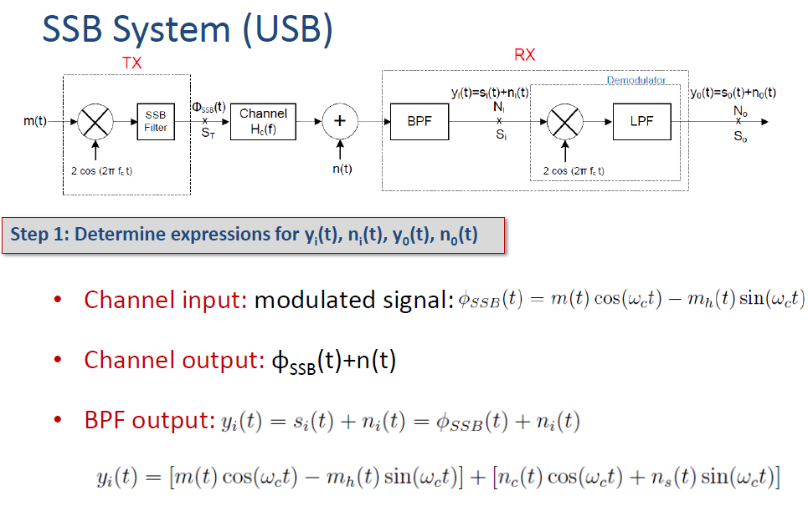
(Note: Both inphase and quadrature noise appears)

Slide 43
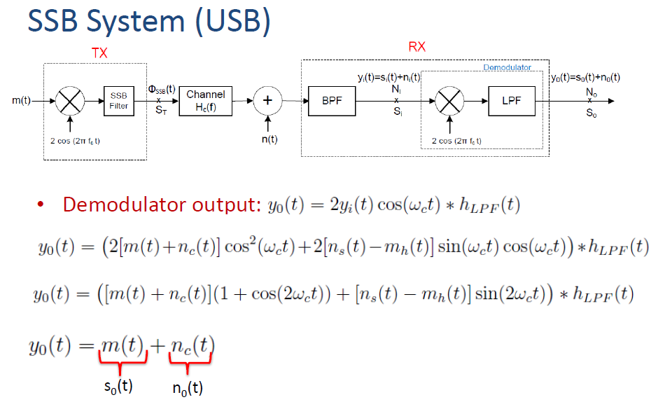
(Note: Only inphase noise appears here)

Slide 44
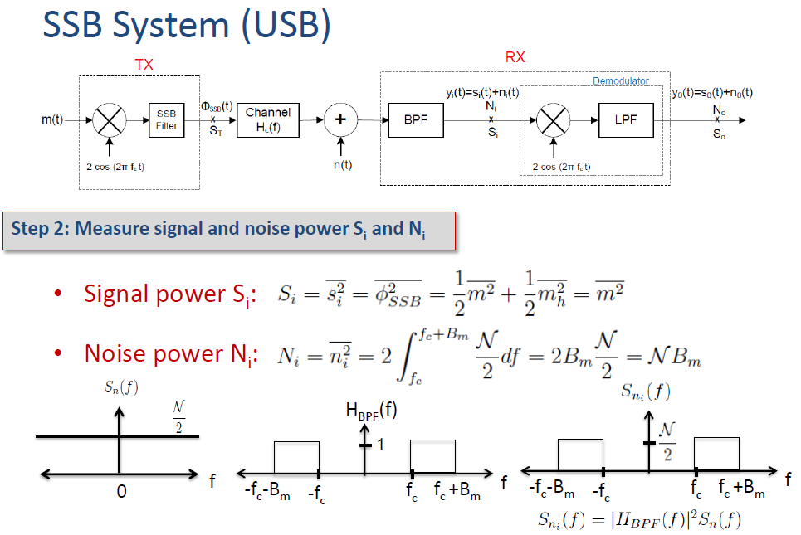

Slide 45
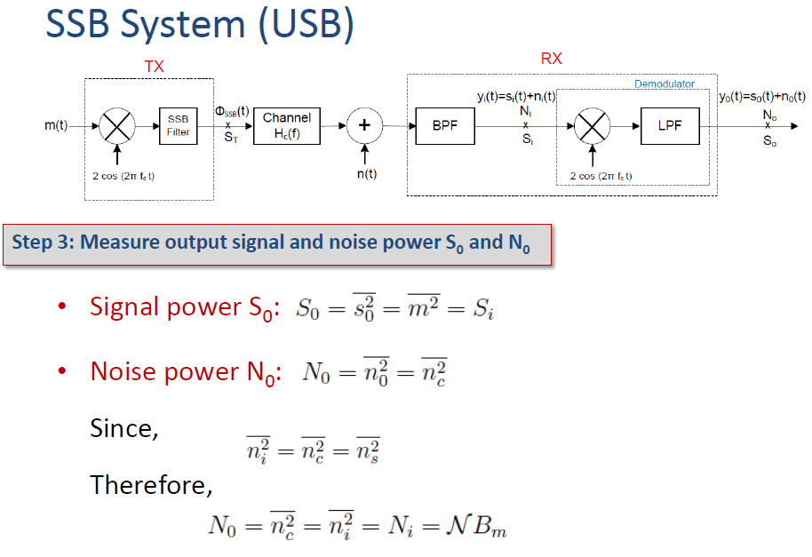

Slide 46
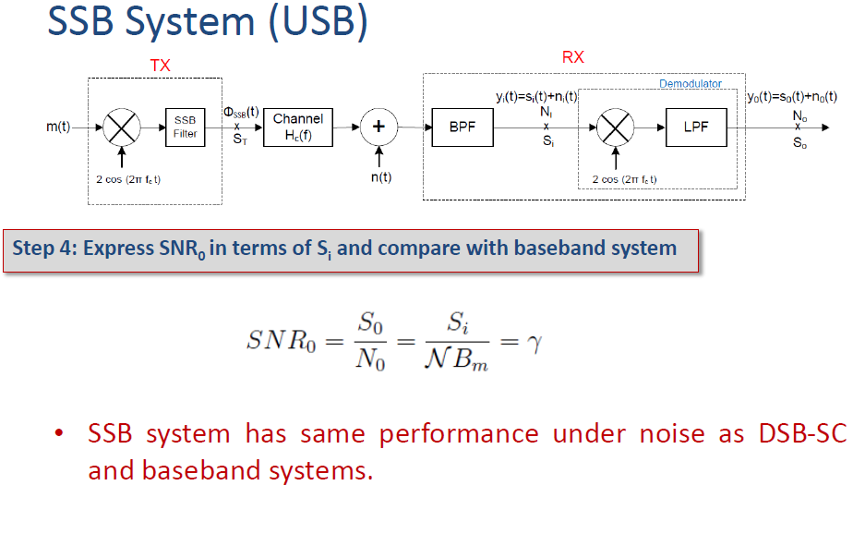

Slide 47
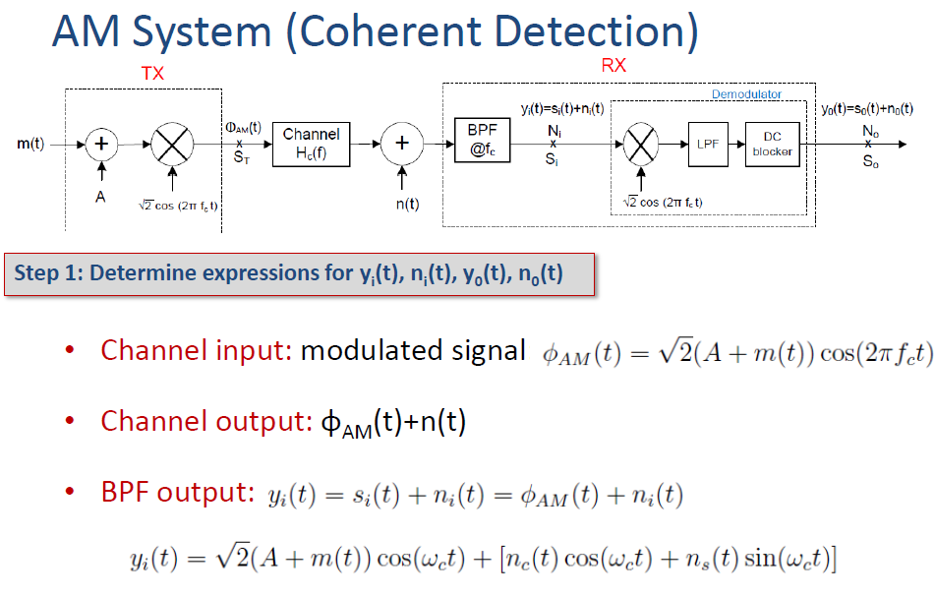

Slide 48


Slide 49


Slide 50


Slide 51


Slide 52


Slide 53


Slide 54


Slide 55



Slide 56


Slide 57


Slide 58


Slide 59















Summary
Also ED small noise
 | Baseband | DSB-SC | SSB | AM (Coherent) | AM (ED)
S_{i}
N_{i}
S_{o}
N_{o}
S_{o}/N_{o}

